Slide 1
0x207 – AES Introduction
ECED4406 – Computer Security
Dr. Colin O’Flynn
Dalhousie University.

Slide 2
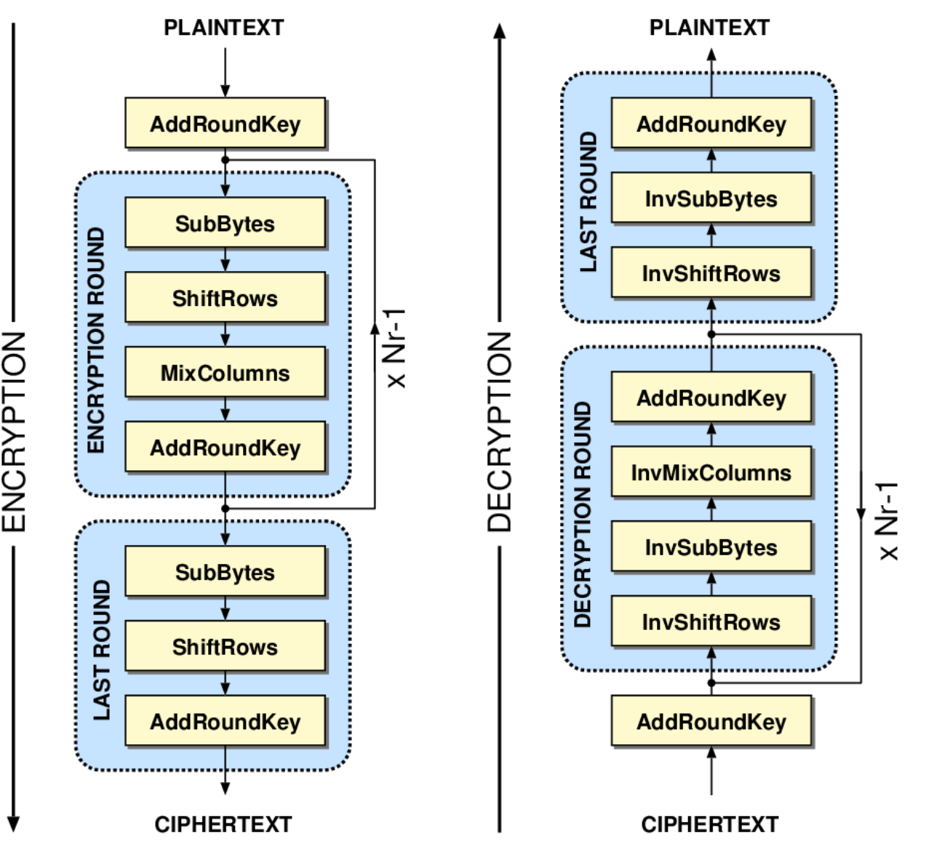
Advanced Encryption Standard (AES)
AES takes 16 bytes of input.
AES generates 16 bytes of output.
The block size of AES is always 16 bytes.
AES can have one of 3 “key sizes”:
AES-128: 16 bytes
AES-192: 24 bytes
AES-256: 32 bytes
Each iteration through the loop is called a round.
A round performs the same operations.

Slide 3
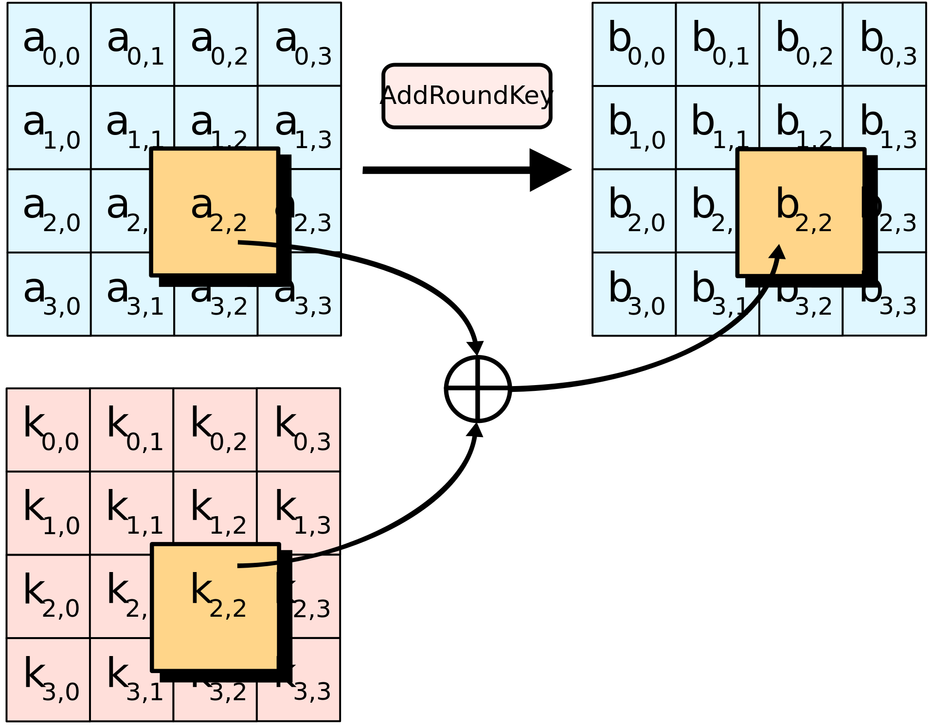
AES Structure Details - AddRoundKey

Slide 4
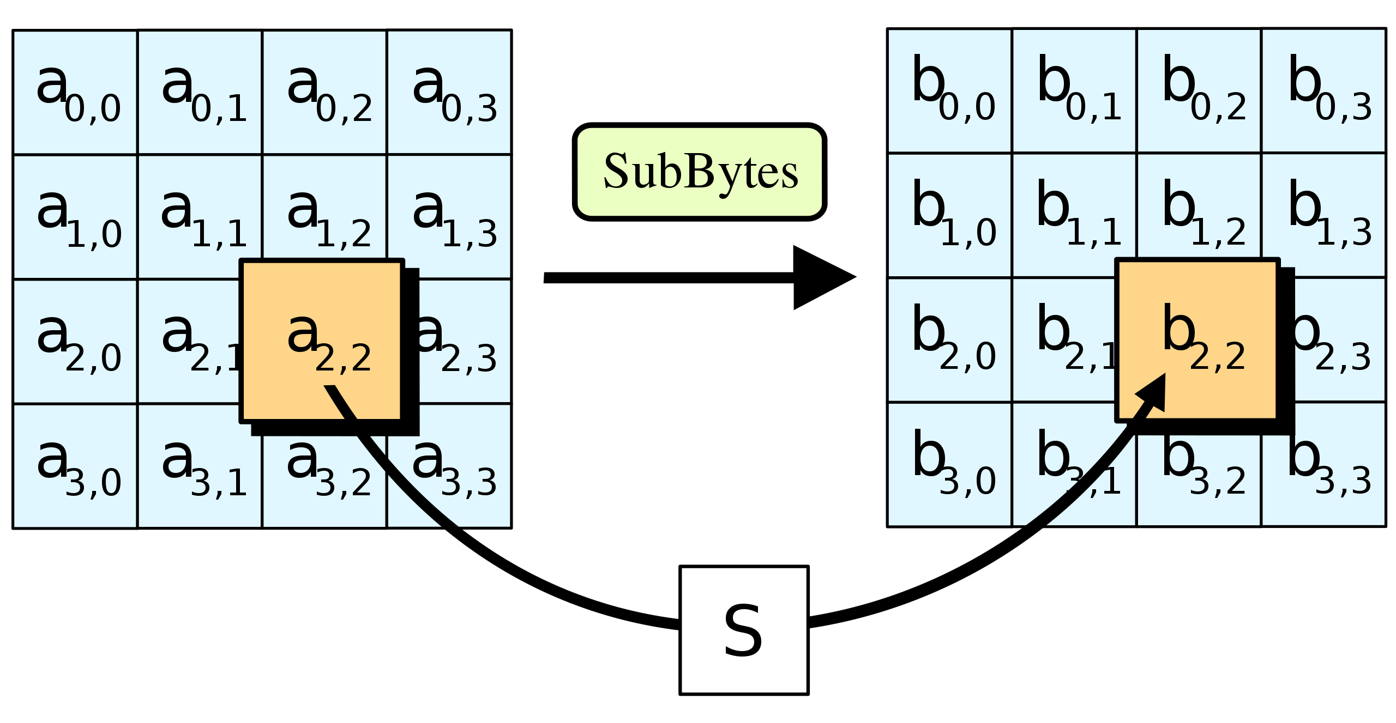
AES Structure Details - SubBytes

Slide 5
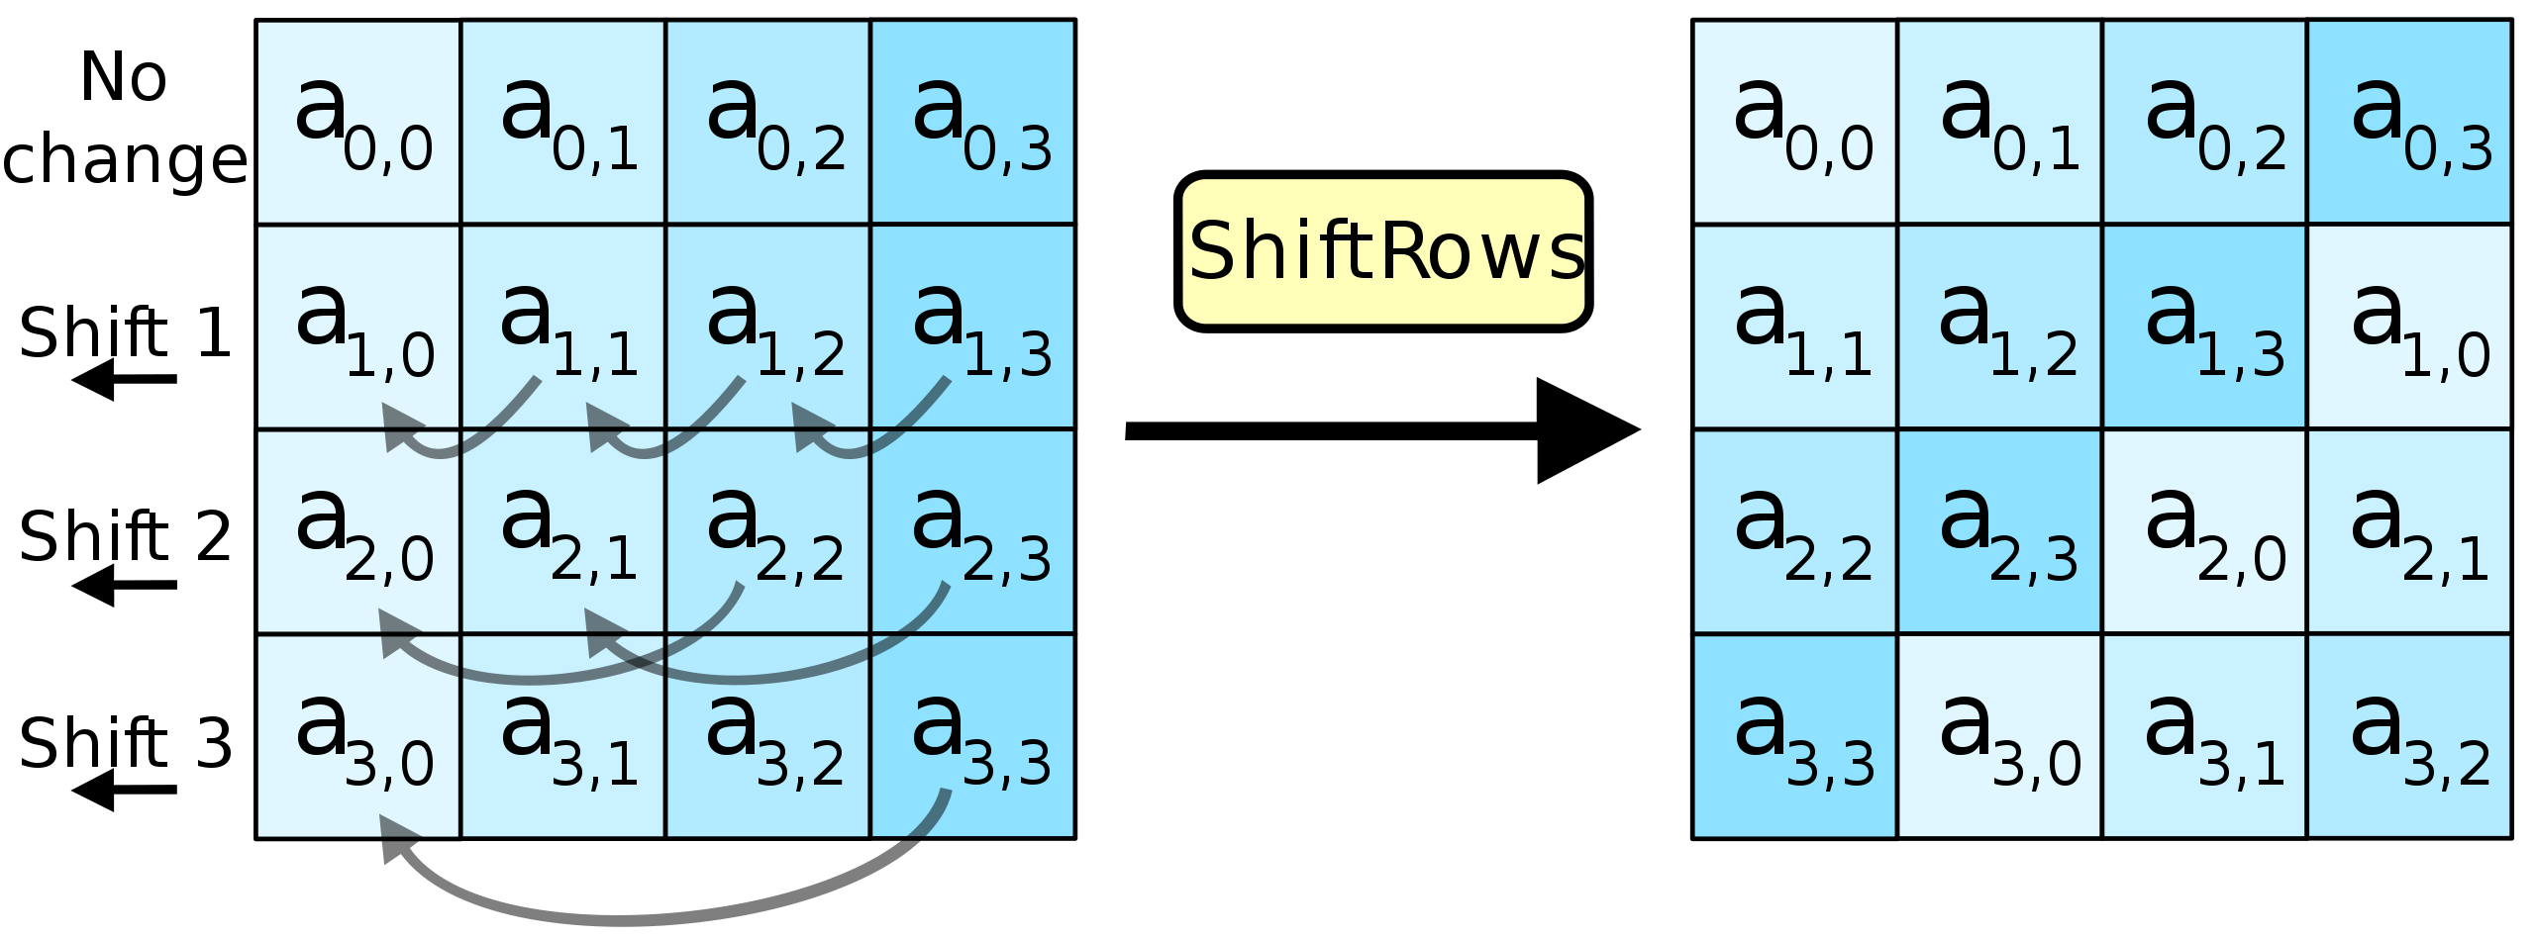
AES Structure Details - ShiftRows

Slide 6
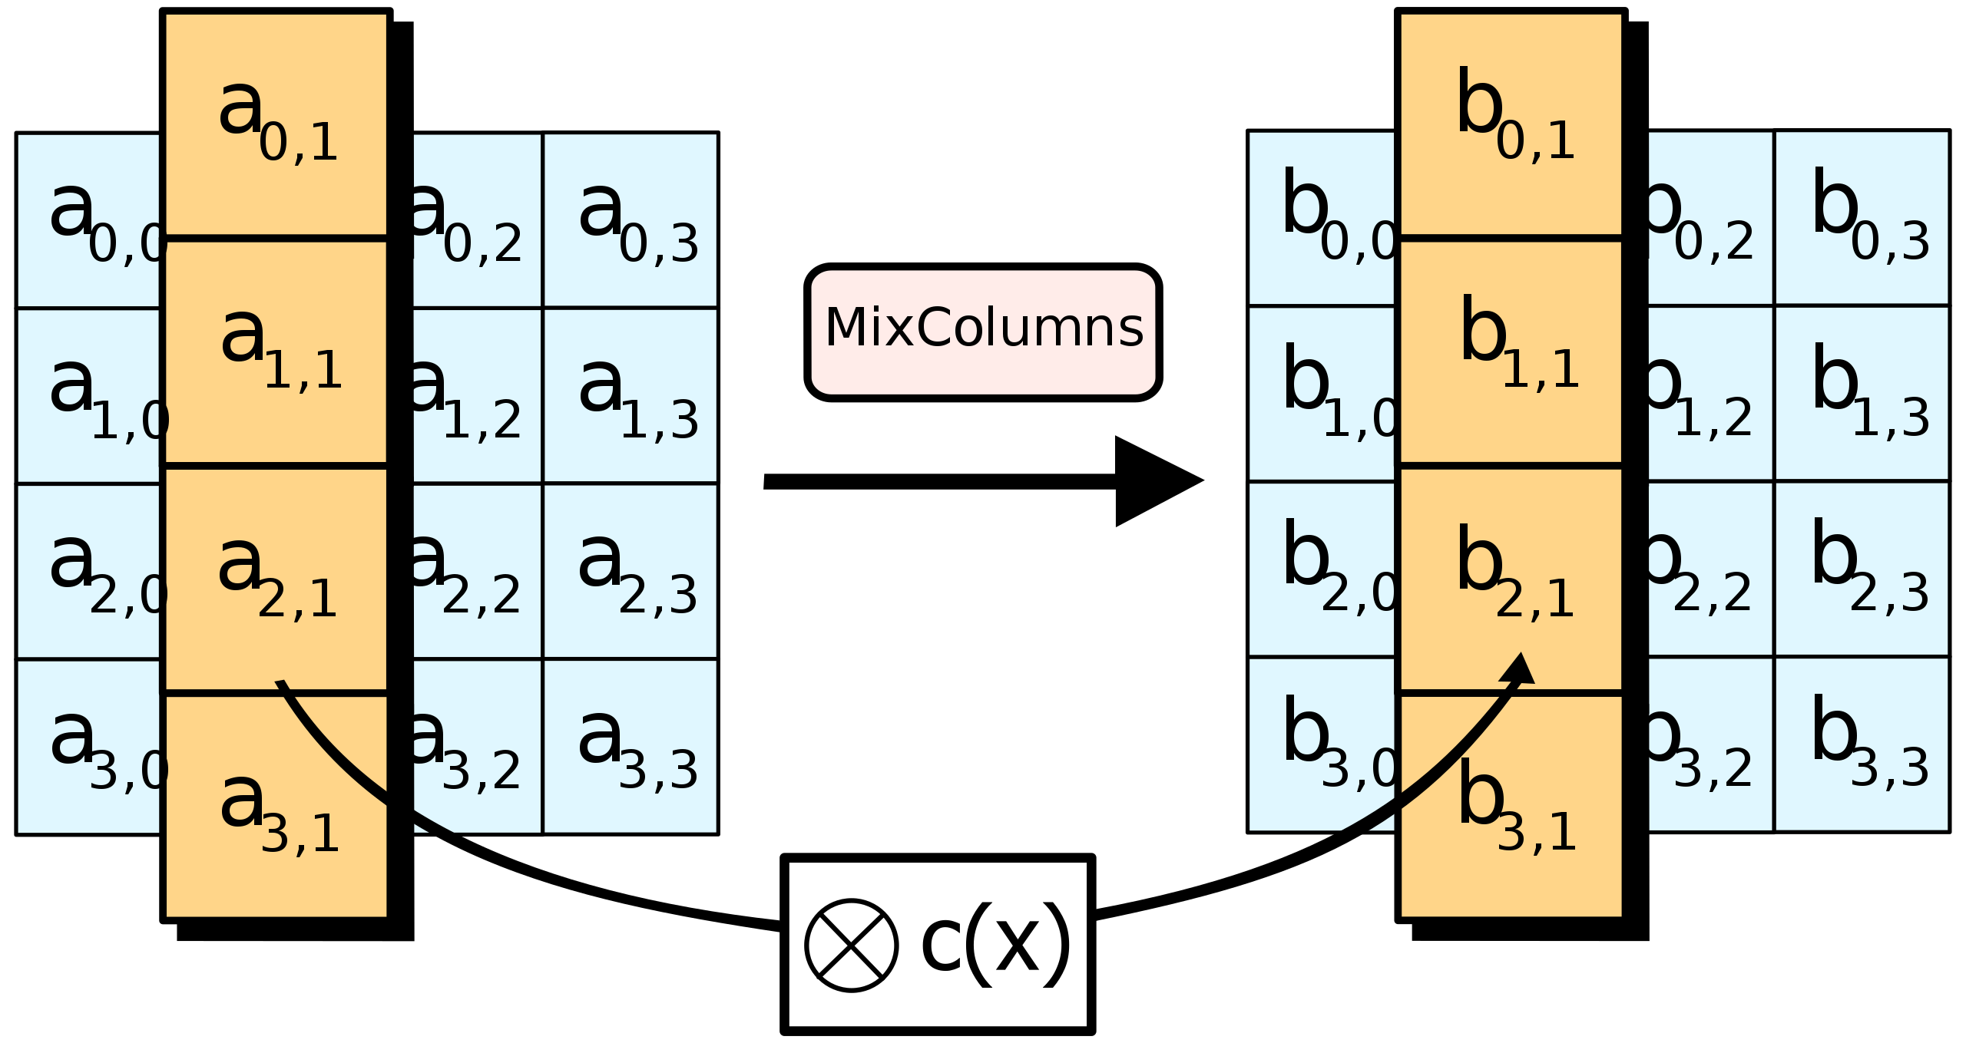
AES Structure Details - MixColumns

Slide 7
Note on Roundkey
AES uses a “key scheduler” to generate a unique key per round.
The round key is derived from the input key – thus this does not add new entropy (security).
That is - finding any round key would allow you to recover all other round keys.

Slide 8
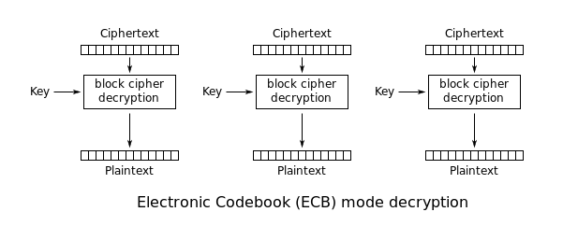
AES Usage in Base Form

